Slide 1
Structured Data Capture
For Da Vinci Documentation Templates & Rules
Lloyd McKenzie
Feb. 24, 2021

Slide 2
Structure of a Questionnaire
Questionnaire
Metadata
Item
(Group, Question or
Display)

Slide 3
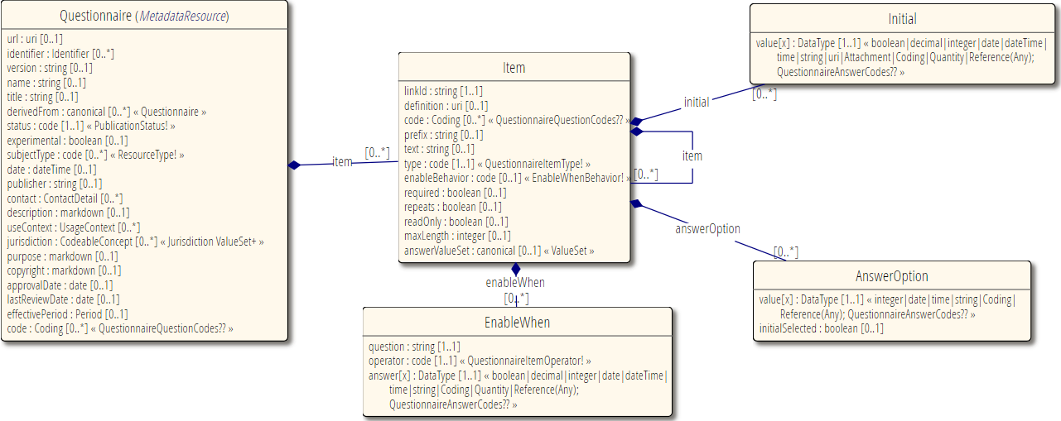
Questionnaire

Slide 4
Types of Item
Groups
Organize content of questionnaire
Must have children
Can’t have answers
Questions
Solicit information
Must have answers (but can be optional)
Display
Additional text, no children, no answers

Slide 5
Anatomy of a Question
5.a) What pizza toppings would you like?
(choose at least 1)
Cheese
Ham
Mushrooms
Other
(please specify): ____________
Prefix
Text
Child “display” item (implies required = true, repeats = true)
option or options
Nested “question” item (enableWhen tied to “Other” answer)
Notes:
Options allows you to point to a value set, option allows enumerating individual potential elements

Slide 6
What is Structured Data Capture (SDC)?
Standardize/enhance capabilities of FHIR Questionnaires:
Workflow
?Complex form rendering
?Complex form behavior
**Automatically populating forms
Automatically extracting data from completed forms
Adaptive forms

Slide 7


Complex form rendering
Have questions/instructions render the way you want
Pick at least one green option and no more than one red option
How are you feeling today? is “great”, is “horrible”
Hide or mark certain questions as ‘read only’ (e.g. calculated score)
Should questions be a grid or table? Should a question use a dropdown? Checkboxes? Radio buttons?
And within that, how wide should columns be, what should column headings be, what should the steps on a slider be, etc.
Additional display guidance.
Social Security number:
nnn–nnn-nnn

Slide 8
Complex form behavior
EnableWhen questions based on expressions
If the total score from group 1 > 30, then display these additional cardiology questions
EnableWhen options
Only display “pregnancy” in “reason for absence” if gender = F
Constraints
Can have a maximum of 2 questions with an answer of “most preferred”

Slide 9
Complex form behavior (cont’d)
Constrain values
5-10 characters
January 1-March 30
YYYY-MM
Must be a JPG or PNG, < 500KB
Must be lb or kg
Minimum 3 choices, maximum of 5

Slide 10
Complex form behavior (cont’d)
Constrain references
Answer must be Condition or “Diagnosis Observation”
Possible answers are: Observation?patient=$patient.id&code=12345-5&…
“Click here to create a new value” (launches new questionnaire)

Slide 11
Complex form behavior (cont’d)
Perform calculations (e.g. scores)
Launch context – patient, encounter, etc.
Use CQL or FHIRPath for calculations
Variables, initial expressions
Create forms constructed from other forms

Slide 12
Pre-population
Requires:
context/source
mapping
processing engine
Knowledge of source structures (particularly profiled scope)

Slide 13
Pre-population
Current $populate Options:
Observation based
FHIRPath/CQL based
StructureMap based

Slide 14

Pre-population – FHIRPath/CQL based
Source
Context may be provided in parameter, or SMART
extension questionnaire-launchContext
Mapping
FHIR Path expressions for each property to map
extension “questionnaire-itemContext”
Extension “sdc-questionnaire-initialExpression”
Leverage variables to assist in calculations
Extension “variable” uses Expression datatype
More Flexible, requires knowledge of FHIRPath, CQL and FHIR Queries to create the mappings
Can also use “sdc-questionnaire-candidateExpression” and “sdc-questionnaire-contextExpression” to guide users answers

Slide 15
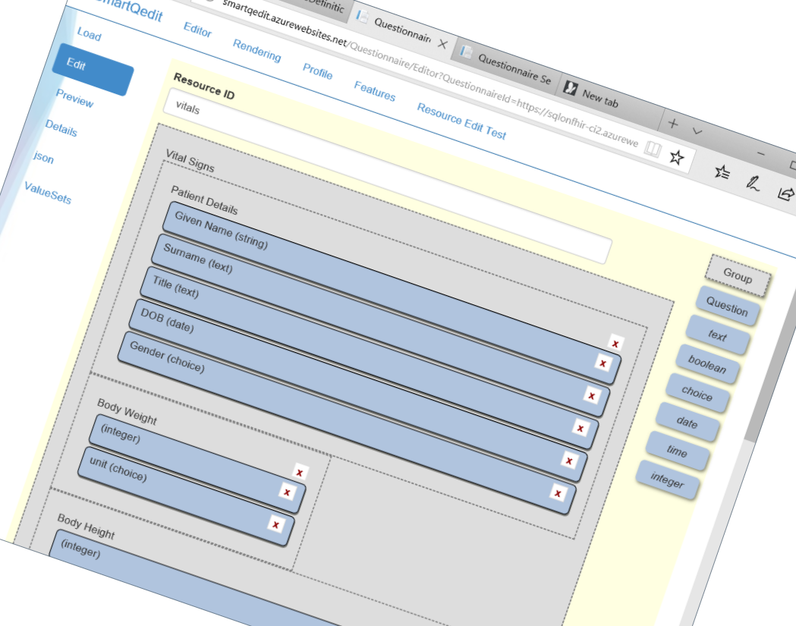
Authoring & filling tools
https://confluence.hl7.org/display/FHIRI/SDC+Implementations

Slide 16
Exploring the SDC spec
http://hl7.org/fhir/uv/sdc

Slide 17
Demo and hands-on
https://lhcforms.nlm.nih.gov
http://ui.hl7.beda.software
http://smartqedit4.azurewebsites.net

Slide 18



Questions / Discussion
lmckenzie@gevityinc.com http://hl7.org/fhir/uv/sdc
Or, better yet, include the community and ask/discuss on chat.fhir.org

